Slide 1

Poster Sessions: Design and Delivery 101
Dr. Jen Craft Morgan, Dr. Kyle Bower, Debby Yoder, and Lee Ann Ferguson
Southern Gerontological Society Webinar
All materials exhibited during this webinar were donated as examples for the purpose of poster construction instruction. All research, images, and results are the property of each researcher/author.

Slide 2
Webinar Etiquette:
Please mute your audio during the presentation to diminish background noise or potential disruptions.
On your Ring Central panel there is a chat feature. If you have a question, please type it into the chat box to the host and we will address it as time permits.
There will be a Q&A session at the end of the presentation.
This webinar is being recorded and will be published on the SGS resource website. Participation in this webinar acts as consent to be published in this webinar video.

Slide 3
Why present a poster?
For many disciplines, posters are the “go to” way to share your research findings.
Posters are great for in progress work or succinctly presenting finished work to different audiences.
Posters allow you to have a conversation with the audience and tailor your message to the intersection of interests. It’s a great way to get feedback from a stakeholder group or from colleagues on different approaches to your findings.
Posters also allow similarly interested conference attendees to find you on the program and reach out to you for potential collaboration or consultation.
It’s a great first presentation type for students as it is low key and flexible to multiple types of information or studies.

Slide 4
What to expect during your poster session.
You should be prepared to give your elevator pitch about your poster. This is basically 1-3 minutes on what your poster is about and what you found. It should help the listener understand what brought you to the topic and highlight interesting methods, results and conclusions briefly. DO NOT read the poster to listeners.
Oftentimes, poster presenters get questions about what’s next after they conclude this particular part of the study. If asked, this is a good time to provide your career/educational context, what your research/project agenda looks like and how it fits into your career plan. Remember, many of the attendees are potential future employers or collaborators.
If you are a student and choose to have your poster considered for judging, you will be visited by one or more judges. They may or may not introduce themselves as such but they are usually carrying clipboard or scoring sheet. Make sure to give your full elevator speech highlighting each section of your poster.

Slide 5
SGS Specifics for Poster Presentations
Presenters must submit an abstract during the Call for Presentations. Check the website (www.southerngerontologicalsociety.org) for dates and directions on how to submit abstract information.
Poster display boards are 48 inches tall and 96 inches wide. We encourage posters to be sized at no more than 40 inches tall and 90 inches wide. 36” by 48” size is somewhat standard and usually easiest to print.
Students wanting their posters judged for the SGS student poster award need to register online for judging at:
  https://southerngerontologicalsociety.org/awards-student-poster.html
Students entering the poster award will also need to check-in with the SGS registration booth to receive a special SGS sticker that will be placed on the poster board and act as a signal for poster judges.
Student posters are exhibited during the opening night of the conference, Tuesday, April 9, 2018. Please plan to be at the venue at least one hour before the poster session begins to hang your poster.
Poster display boards will be marked with assignment tags. Be sure to find the board marked with your tag before hanging your poster. Do not move tags for any reason.

Slide 6
APA Standards & Style

Slide 7
APA Standards & Style
Title
  Do not capitalize all the letters in the title
  Example: The girl who knows everything: A biography of Kyle Bower
  Helpful tip: Choose a title that captures the interest of an audience and orients the audience to the poster’s content
Imbedded citations
  Follow APA writing standards
  Example: (Braeburn & Gala, 2014; Smith & Fuji, 2017)
  Helpful tip: Make text slightly smaller than text to save space
Formatting tables, graphs, charts, and pictures
  Follow APA writing standards
  Examples: see Purdue Owl, tables and figures
  Helpful tip: use a visual to summarize complex ideas or findings
Citation list:
  Follow APA writing standards
  Example: Smith, G. & Fuji, A. (2017). The phenomenology of fall fruit. Journal of Seasonal Benefits, 1(16), 11-22.
  Helpful tip: Do not include every citation mentioned in the original paper, only those that appear on the poster need to be cited

Slide 8
Charts & Graphics
Is the figure/table necessary?
Is the figure/table simple, consistent, and free of extraneous detail?
Are the data displayed accurately?
Is the figure correctly proportioned? Proper spacing in tables?
Are terms spelled correctly?
Are all abbreviations and symbols explained in a figure legend or figure caption? Are they consistent in other figures?
If the table or its data are from another source, is the source properly cited?
Figure 1: How to format tables and graphics using APA standards.
Source: Purdue Owl https://owl.purdue.edu/owl/research_and_citation/apa_style/apa_formatting_and_style_guide/apa_tables_and_figures_1.html
Notes:
After looking closer at this poster, it’s not the best example of APA. I suggest removing it from this spot or removing entirely from presentation.

Slide 9

Mental health services usage among Asian & Latino elders:
Results from the NLAAS study
James R. Muruthi, Kyle L. Bower, Denise C. Lewis
University of Georgia
Table 1. Descriptive characteristics of select demographic variable.
Discussion
Background & Significance
Characteristics | Latino individuals (N = 270) N (%) | Asian individuals (N = 211) N (%)
Age (mean) | 68.9 | 68.70
Sex (Female) | 159 (59%) | 104 (49.3%)
Married | 135 (50%) | 159 (75.4%)
Education (<12 years) | 182 (63.1%) | 77 (31.3%)
Years of residence (< 20) | 54 (20%) | 133 (46%)
Income (< $ 50,000) | 205 (76%) | 126 (60%)
Older immigrants who migrate to the United States (U.S.) report difficulty acculturating (Gonzalez, 2007)
Stressors unique to the experience of migration and resettlement that may exacerbate or cause mental health problems
Access mental health care at disproportionately lower rates than the general population
Negative experiences may trigger mental health concerns
Results call for multi-dimensional prevention strategies that address mental health concerns in the context of immigration (Kim et al., 2011; Kim et al., 2010; Song et al., 2010)
Specifically, results indicate a heightened need to focus on prevention and treatment on mental health disorders among aging immigrants
  E.g. Screen for mental health using the Geriatric Depression Scale and Geriatric Anxiety Inventory among aging immigrants in the U.S. (Lin et al., 2016)
Results
Both Immigrant Populations:
  Poor self-rated mental health, female gender, poor English language proficiency, and mental health episodes is associated with significantly greater mental health service use, even after controlling for other predictors
Asian Older Adults:
  Use of mental health services is significantly associated with mental health episodes
Objectives
Limitations
Examine factors that influenced the usage of mental health services among Asian and Latino older adults (50+) in the U.S
Explore whether physical health ratings were significant health need factors associated with the use of mental health services
Data were subject to reporting bias as the surveys used retrospective measures
Possible within-group differences were missed due to grouping, based on nationality, SES, and culture
Table 2. Hierarchical Regression Model.
 | Total Sample (N = 481) | Asian Elders (N = 270) | Latino Elders (N = 211)
Step Predictor | Odds ratio (95% CI) | Odds ratio (95% CI) | Odds ratio (95% CI)
1 Demographics
Age | 0.03 [0.97, 1.10] | -0.08 [0.08, 1.08] | 0.05 [0.97, 1.15]
Female | 1.42 [1.45, 11.68]*** | 0.63 [0.26, 13.51]* | 2.24 [1.43, 61.57]***
Education (<12yrs) | 0.99 [0.94, 7.80] | 1.76 [0.20, 68.75] | 0.74 [0.26, 4.46]
Health insurance | -0.07 [0.71, 1.22] | -0.12[0.54, 4.43] | -0.06 [0.66, 1.33]
Married | -0.33 [0.27, 1.95] | -0.55 [0.03, 10.14] | -0.21 [0.20, 3.30]
Household income | -0.14 [1.23, 14.65] | -1.46 [1.07, 12.86] | -1.41 [0.79, 11.12]
2 Acculturation Factors
Years in the U.S. | 0.11 [0.24, 5.25] | -2.51 [0.14, 2.24] | 1.51 [0.30, 67.61]
ELP | -1.47 [0.06, 0.88]** | -0.73 [0.1, 31.54]* | -2.65 [0.01, 0.55]**
3 Physical Health
SR physical health | 0.35 [0.85, 2.36]* | 0.85 [0.77, 7.09] | 0.15 [0.54, 5.90]
Chronic condition | 0.12 [0.34, 3.72] | 1.75 [0.31, 96.67] | 0.06 [0.19, 5.90]
4 Mental Health
SR mental health | 0.35 [0.84, 2.43] | 1.42 [0.84, 20.37] | 0.46 [0.47, 2.12]
Mental health issue | 1.29 [0.96, 13.70]* | 1.23, 56.42]* | 2.75 [2.29, 60.15]**
Methods & Materials
211 Latino, 270 Asian immigrants
National Latino and Asian American Survey (NLAAS)
Hierarchical regression model
  Demographics
  Acculturation factors
  Physical health
  Mental health
Notes: ELP = English language proficiency; SR = self-rated; dependent variable = mental health service use. *p < 0.05; **p < 0.01; ***p < 0.001.
Contact
References
James R. Muruthi
University of Georgia
Email: jrmuruthi@uga.edu
Kim, G., Loi, C. X. A., Chiriboga, D. A., Jang, Y., Parmelee, P., & Allen, R. S. (2011). Limited English proficiency as a barrier to mental health service use: A study of Latino and Asian immigrants with psychiatric disorders. Journal of Psychiatric Research, 45(1), 104-110.
Kim, G., Jang, Y., Chiriboga, D. A., Ma, G. X., & Schonfeld, L. (2010). Factors associated with mental health service use in Latino and Asian immigrant elders. Aging & Mental health, 14(5), 535-542.
Lee, S., & Matejkowski, J. (2012). Mental health service utilization among noncitizens in the United States: findings from the National Latino and Asian American Study. Administration and Policy in Mental Health and Mental Health Services Research, 39(5), 406-418.
Song, H. J., Han, H. R., Lee, J. E., Kim, J. Y., Kim, K. B., Ryu, J. P., & Kim, M. (2010). Does access to care still affect health care utilization by immigrants? Testing of an empirical explanatory model of health care utilization by Korean American immigrants with high blood pressure. Journal of immigrant and Minority Health, 12(4), 513-519.

Slide 10
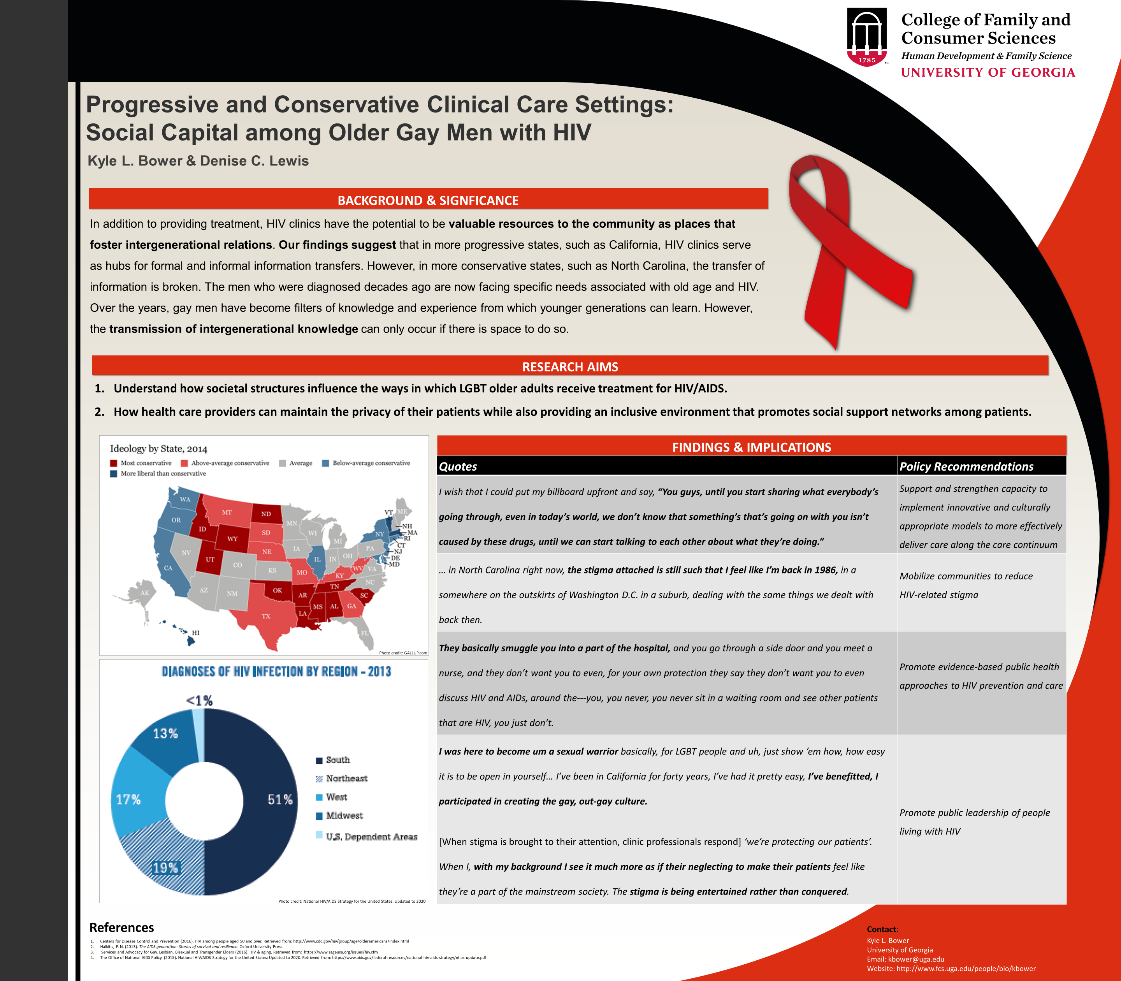
Colors and Font
Color
  Affiliation with school, organization , or cause
  Choose colors that compliment each other
  Avoid colors that are too distracting
  Avoid colored text, you never know who is color blind or has difficulty reading
Font
  BASIC fonts are best
  Consistency with font and font styles
    Bolding
    Italics
    Underlined
  Headings need to be consistent
  Proper spacing of text is critical (if you have the space, USE IT!)

Slide 11

Photos
Be sure to have model releases of anyone who is featured in a photograph.
Use high quality, high resolution photos to eliminate blurriness and pixilation.
If it is not a photograph you took yourself, you must cite the source of your photograph.
Best practice: cite even your own photos.

Slide 12
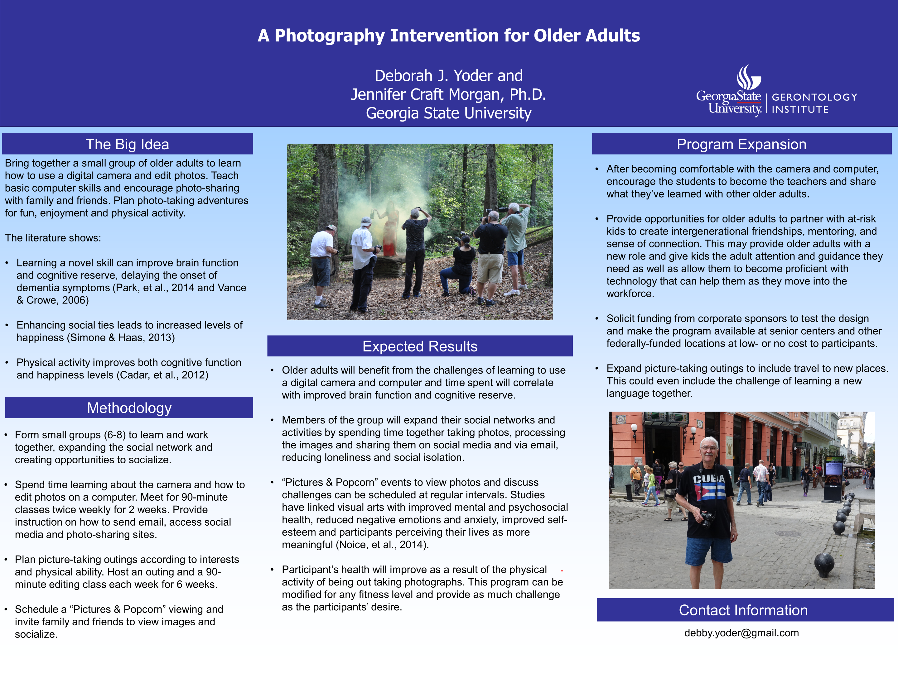
Clean and Simple, Easy to Read

Slide 13
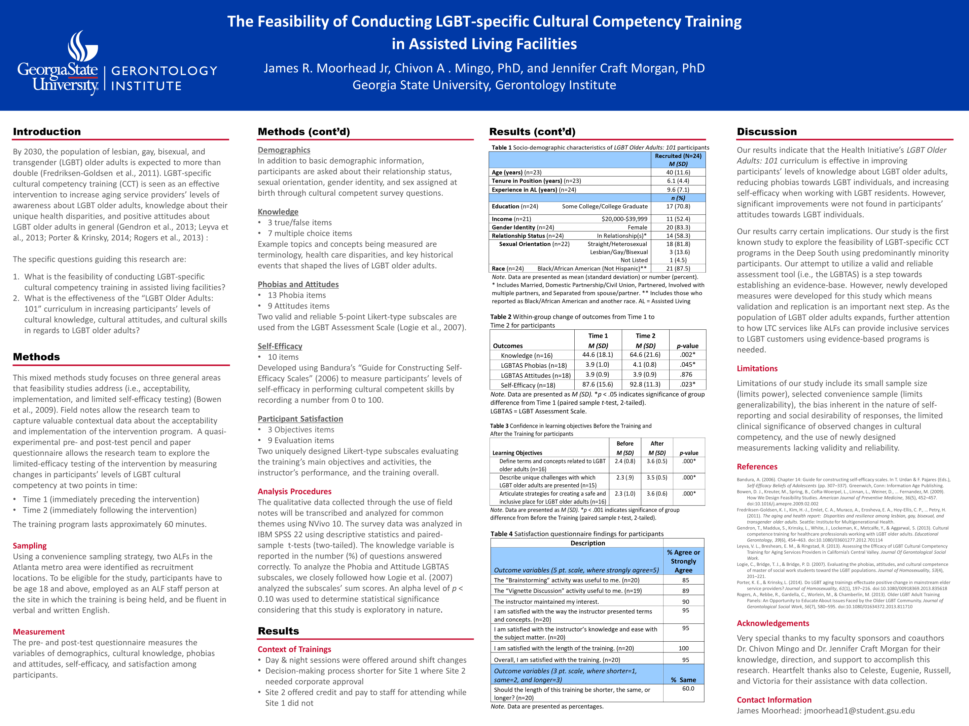
Details to include or omit

Slide 14
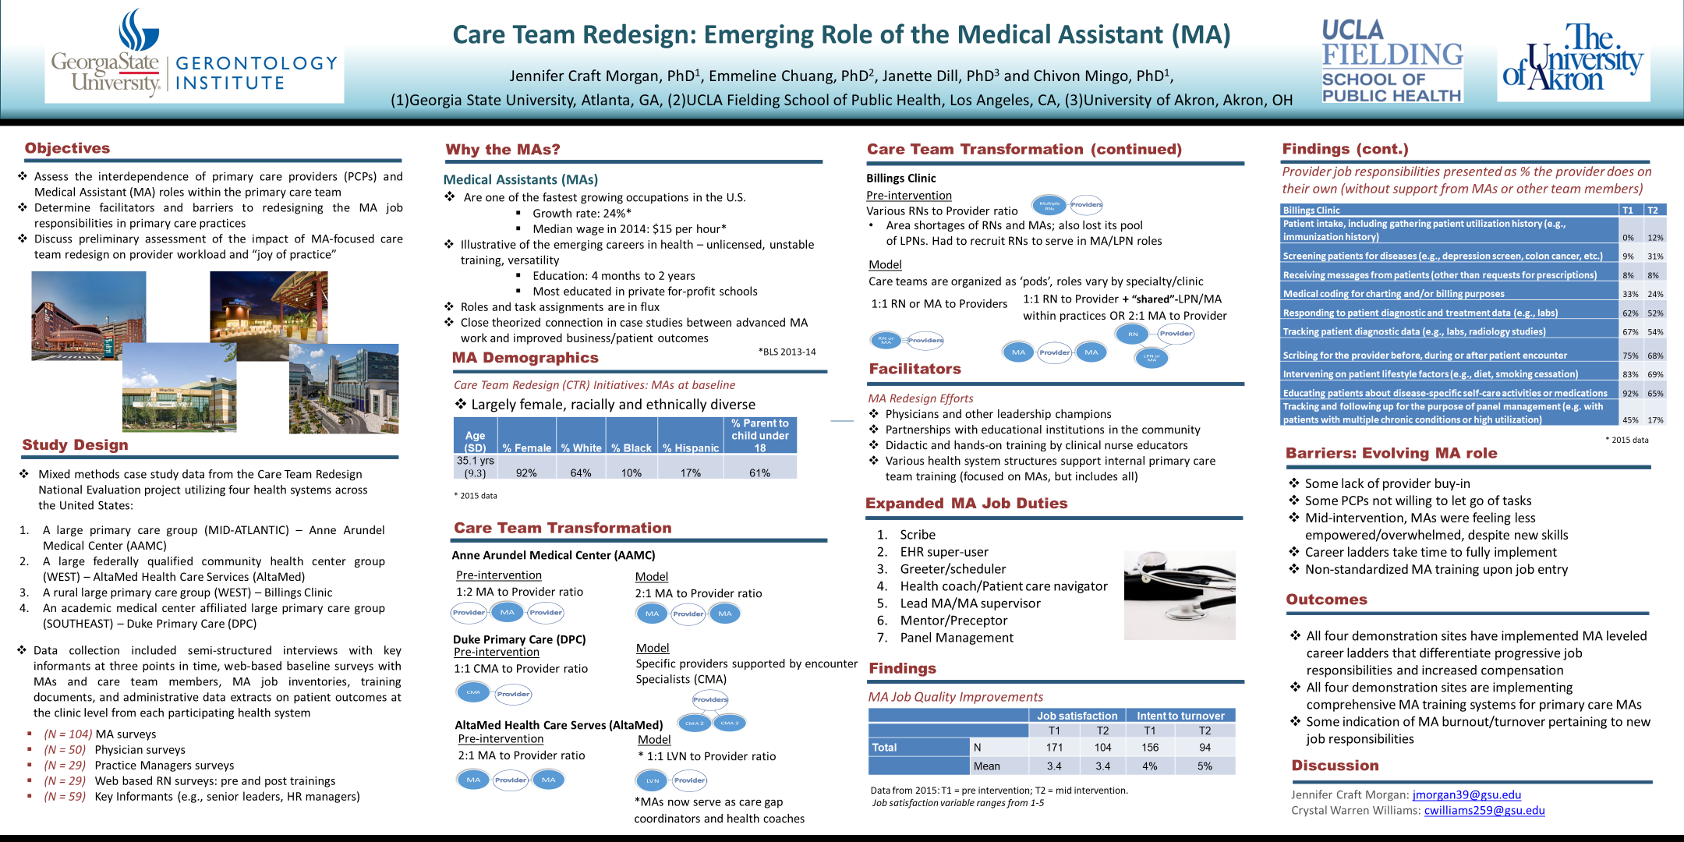

Slide 15
2017 Poster Winners
Carol Jacobs
Cheyann Kazemian

Slide 16


Slide 17
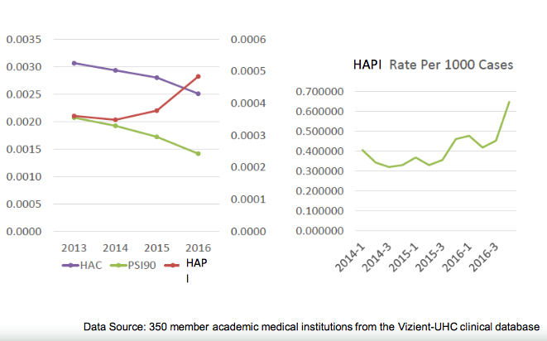

Pressure Ulcers Awareness and Prevention Among the Elderly
Cheyann Kazemian & Jennifer Craft Morgan, PhD.
Gerontology Institute, Georgia State University
Background
Pressure Ulcers Remain an Issue
Next Steps and Implications
According to the National Pressure Ulcer Advisory Panel (NPUAP), there were over 2.5 million patients that develop pressure ulcers every year. With over 60,000 deaths per year since 2012.
In 2011, pressure ulcers costs the U.S. Health System $9-11 billion per year, and is only increasing.
- $70-150 thousand per patient - Stage III/IV.
- $250,000+ per settlement.
- Second most common hospital billing claim
The system is not consistent in all hospital settings. Not every hospital has the same prevention and treatment protocol for pressure ulcers.
Shortage of CNAs seems to be the root of the problem.
Physicians and nurses can only voice an opinion. The data now needs to be taken to administrators.
With the aging population only increasing, pressure ulcers and lawsuits will increase unless proper measures are taken.
Creating an intervention plan for hospitals nationwide to follow a set protocol for prevention and treatment of pressure ulcers.
- All starts with consistent patient movement and logging of movement. This will prevent future law suits.
- Creating more and/or annual continued education courses for nurses and physicians to enforce awareness of pressure ulcers.
- Receive treatment feedback from patients.
Research Objective
Create awareness about the impact pressure ulcers have had over the years on hospitals and patients.
Make physicians and nurses more aware of the importance of treating pressure ulcers, and the consequences it may have on the patient and hospital.
Present the proper techniques, continued education courses and practices for preventing pressure ulcers.
Protocol to prevent pressure ulcers
Are patients’ and families’ that have a prolonged stay in the hospital informed/educated of pressure ulcers? Are they given a brochure or information sheet of some sort? If so, what does it look like and how much detail is given?
Physician: No, the patient and/or family receive no kind of information.
Nurse: Yes, the patient and their family members are educated verbally, not by a brochure/information sheet.
What is the protocol for nurses to make sure the patient is moving to prevent pressure ulcers? How often are they moving the patient? How are they moving the patient?
Physician: N/A
Nurse: Frequent turns: the patient is turned every two hours. The patient’s heels and arms are
elevated via pillows, and patient’s are constantly checked to ensure that they are clean and dry.
Is there some sort of log or time sheet for every time a patient is moved?
  Physician: N/A
  Nurse: Frequent turns are charted on ADL’s.
What kind of education did you get in the past about pressure ulcers? Do you take any continued education courses about pressure ulcers?
Physician: Some training during fellowship. I didn’t personally take any other course.
  Nurse: There is a wound care class that must be taken, and there is also a pressure ulcer survey that must be taken.
Treatment if a patient has pressure ulcers
When a patient gets a pressure ulcer during their stay at the hospital, what is the protocol of informing the patient of the occurrence?
Physician: Verbally.
  Nurse: The nurse will let the patient know that a pressure ulcer has formed and that that specific area needs to be elevated and there will be more frequent applications of crèmes/borders and possibly more frequent turns.
What information are they given now, that they didn’t get before, about getting pressure ulcers? A brochure, a packet?
  Physician: N/A
  Nurse: There is no brochure or packet given, however the patient is given a more detailed description as to the steps that will be taken to heal the pressure ulcer and to prevent it from worsening.
What is the protocol of treating a patient with pressure ulcers?
Physician: Wound Care Team will visit daily.
  Nurse: Patient will continue to be turned frequently and the area of the ulcer will be elevated to prevent worsening. depending on the severity, different precautions will be taken. Baza crème is used for initial pressure ulcers, but if the pressure ulcer is sever and deep a mepilex border will be put on the patient.
What cleansing and wrapping technique is used to treat the pressure ulcer? How often?
  Physician: N/A
  Nurse: Baza crème and mepilex borders are used.
Acknowledgments
Georgia State University Gerontology Department
Grady Hospital
Nation Pressure Ulcer Advisory Panel
Northside Hospital
References
Research Strategy and Methods
Padula, William. “Let’s Start at the Top: Getting Administrative Buy- In.” National Pressure Ulcer Advisory Panel, 3 Mar. 2017, www.npuap.org/ wp-content/uploads/2017/03/Padula-William- NPUAP-13FEB17.pdf.
Padula WV, Mishra MK, Makic MB, Sullivan PW (2011). Improving the Quality of Pressure Ulcer Care with Prevention: a cost- effectiveness analysis. Med Care 49(4): 385-392.
Research proper/successful protocol and treatment for pressure ulcers
Ask nurses and physicians a set of questions about protocol, treatment, and methods of prevention of pressure ulcers.
- Grady Hospital
- Northside Hospital
Identify where improvements can be done in the hospital setting.
*
Contact Information
Cheyann Kazemian: ckazemian1@student.gsu.edu
Jennifer Craft Morgan: jmorgan39@gsu.edu

Slide 18
Other items to consider
Poster printing options:
  Check with your university about inexpensive student options.
  Check with your Sigma Phi Omega chapter to determine if there are student discounts
  There are online printers (postersmith.com, spoonflower.com, etc.).
  Fabric posters are more expensive but they travel easily, and can be folded without damaging the posters.
Traveling with your poster
  Shoulder strap poster tube (available on Amazon, $14-$25 in price range)
  Cardboard tubes are sometimes available through printer
Shipping options
  You may choose to ship your poster directly to the conference venue but you do so at a risk. Shipping loss and misplacement by conference venue does happen.
Supporting Materials:
  Have handouts of your information available
  Have business cards available (place on your poster board).
  While SGS provides tacks to post your board up, always bring extra tacks, binders clips, and/or tape to secure materials (like handouts and business cards) to the board.

Slide 19
Questions & Answers: The floor is now open
Award Application Deadlines:
Student Travel Scholarship: February 15, 2019
Student Paper Award: February 15, 2019
Student Poster Award:
Be sure to indicate on your abstract submission that you would like to be considered for judging.
SGS membership is required to participate in awards and scholarships.
2019 Conference Deadlines:
Call for Presentations Deadline: November 12, 2018
Late Breaker Poster Session Submission Period:
January 7 – February 22, 2019
Recognize your mentors, best practices, excellent media, and older adult advocates! Submit an award nomination today at:
https://southerngerontologicalsociety.org/awards.html

Slide 20
Future Webinars Upcoming Include:
ATLAS.ti for Everyday with Dr. Kyle Bower
Awards for Students and Mentors- How to Apply and Why it’s Important
Technology Help for Older Adults
How Can a Professional Organization Impact My Career?
Become a member of SGS and never miss any news about what's going on next! Membership has many benefits. For more details, visit: https://southerngerontologicalsociety.org/membership.html

